Slide 1
Human Computer Interaction (HCI) – An Introduction
Farrukh Hasan Syed
Assistant Professor
Department of Computer Science

Slide 2
UI/UX
Choosing a specific blue over some other hues amounted to an additional $80 million in annual revenue for Bing
Judgments on web site credibility are 75% based on a website’s overall aesthetics
88% of online consumers are less likely to return to a site after a bad experience

Slide 3
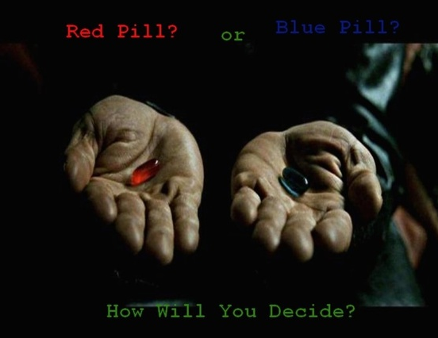

Slide 4


Slide 5
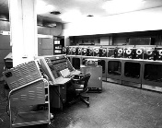
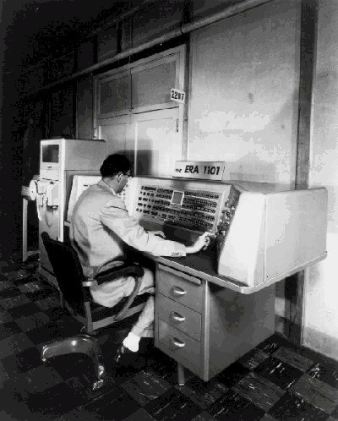
Computers in early era days

Slide 6

Continue…

Slide 7
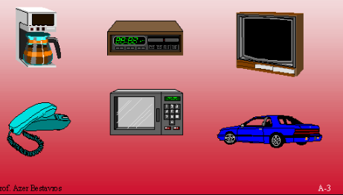

Slide 8
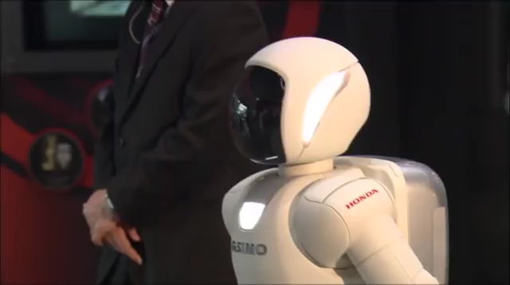
Artificial intelligence

Slide 9
Bright and not so bright side of computers
Computers are enabling new discoveries
Leading to efficiencies
Making our life easy and convenient
Not so bright side
Computers are annoying us
They are infuriating us
They even kill a few of us

Slide 10
Boeing 737 Max 8 jetliner crash
“glitch” in the plane’s flight-control software
killing all 189 passengers and crew
The Maneuvering Characteristics Augmentation System (MCAS) is a flight control software especially in low-speed and high angle of attack (AoA) flight. It lowers the nose without pilot action when it determines the aircraft is too nose-high, based on input from airspeed, altitude and angle of attack sensors.

Slide 11
What is HCI
As its name implies, Human Computer Interaction consists of three parts: the user, the computer, and the ways they work together
Study of how people interact with computers
And to what extent computers are or are not developed for successful interaction with human beings

Slide 12
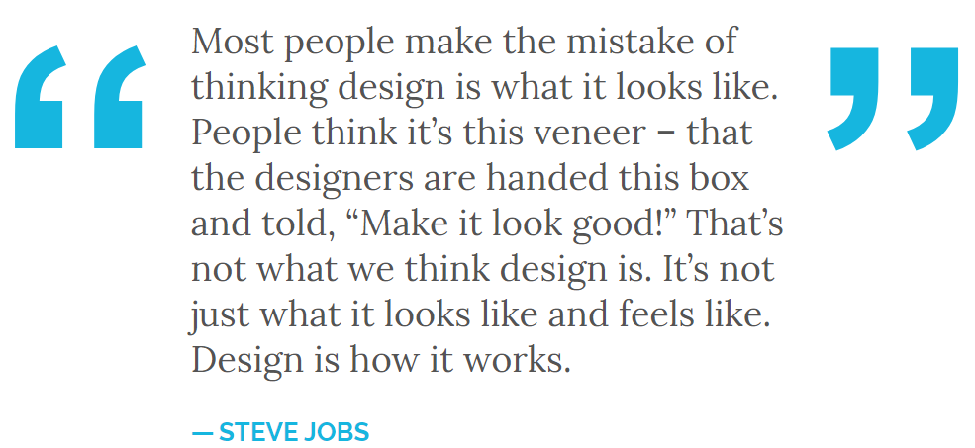

Slide 13
What is HCI
How computers affect humans?
How humans use computers to affect their surroundings?
What are computers used for?

Slide 14
Launch rockets
Map Human Genome
Run nuclear plants
Fly fighter jets
Control room temperature
Play video games
Watch movies
Listen to music
Etc, etc…
What do all of these things have in common?

Slide 15
When you design a system, you also change the way people interact with each other, with the computer, and with the world.
You design interaction.
https://www.youtube.com/watch?v=qqNq6zlv6_A

Slide 16
Goals of HCI
Understand the factors that determine how people use technology
Develop tools and techniques to enable building suitable systems
Improve usability
Define usability

Slide 17
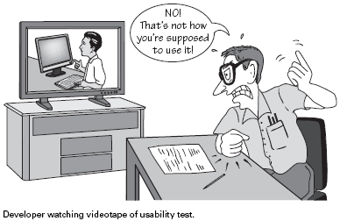

Slide 18
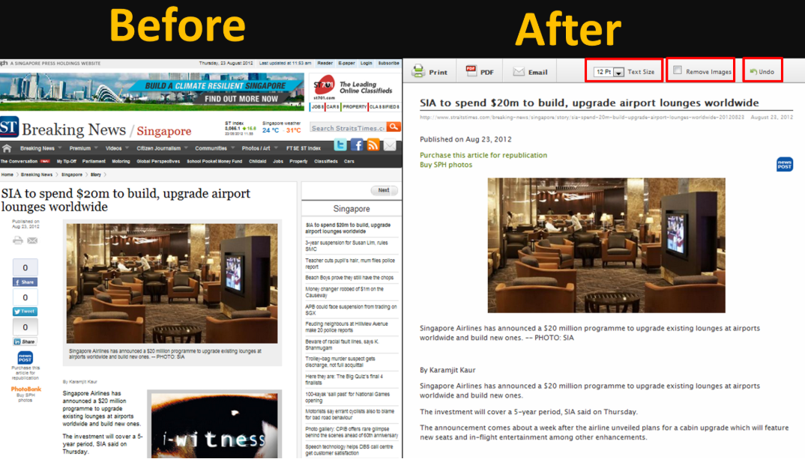
https://cs3240team4.files.wordpress.com/2012/08/blog1.png

Slide 19
HCI surfaced in the 1980s with the advent of personal computing
Sophisticated electronic systems were available to general consumers for uses such as word processors, games units and accounting aids
Douglas Engelbart (the person who invented the computer mouse) saw computers as tools to augment human work
Computers were not meant to be learned, rather, used to solve human problems

Slide 20
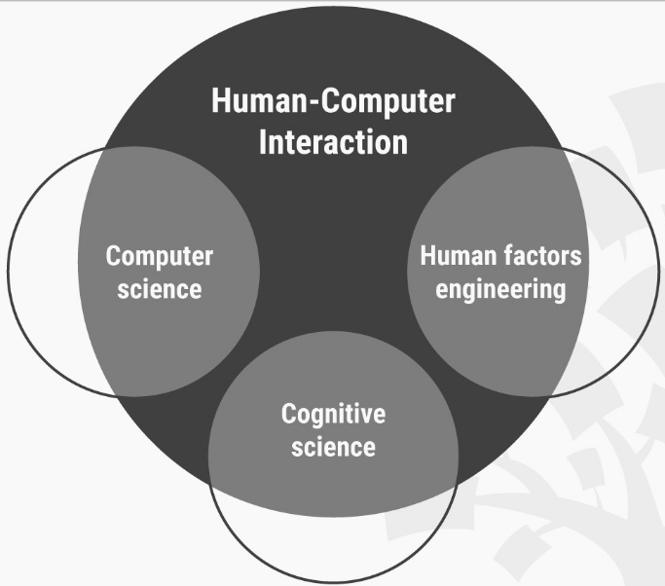

Slide 21
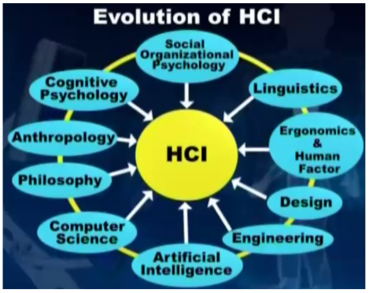

Slide 22
When studying the person, the focus is on physiology, cognitive psychology, and socio-technical action
Physiology: ergonomics, human factors
"Ergonomics is the process of designing or arranging workplaces, products and systems so that they fit the people who use them“
Cognitive: the mental action or process of acquiring knowledge and understanding through thought, experience, and the senses

Slide 23
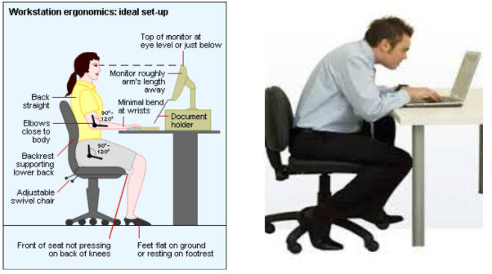
Ergonomics

Slide 24
https://www.facebook.com/GameByte/videos/862431247445498/

Slide 25
What is the order of operations when you go to an ATM?
Why is it like that?

Slide 26
Design of Everyday Things by Donald A. Norman:
“Using a bank or credit card to withdraw money from an automatic teller machine, then walking off without the card. This was a frequent enough error that many machines now have a forcing function: you must remove the card before the money will be delivered. Of course, you then can walk off without your money, but this is less likely than forgetting the card because money is the goal of using the machine.”

Slide 27
Suppose you want to design an alarm system. What would be the better mode(s) of communication?
Display message on screen?
Play alarm sound?

Slide 28
Why HCI is Important
The study of our interface with information.
It is not just ‘how big should I make buttons’ or ‘how to layout menu choices’
It can affect
Effectiveness
Productivity
Morale
Safety
One main aim of interaction design is to reduce the negative aspects (e.g. frustration, annoyance) of the user experience while enhancing the positive ones (e.g. enjoyment, engagement).
Different group of people may have different expectations. Children have different expectations than adults

Slide 29
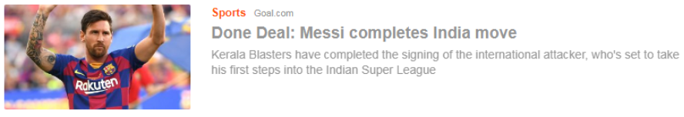
Downsides of Technology

Slide 30

Downsides of Technology

Slide 31
Measures
You design great interface. How do you measure its goodness?
Evaluation criteria

Slide 32
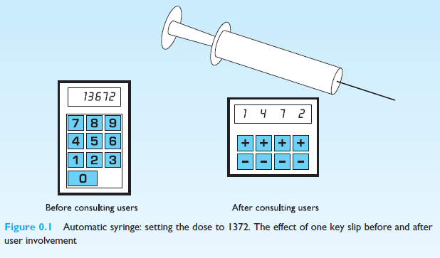
Safety Issues Walk in other people’s shoes

Slide 33
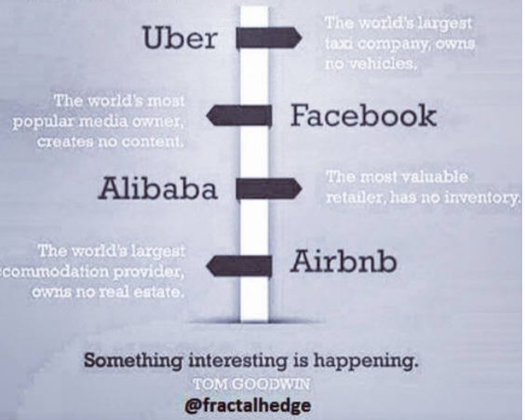
Some interesting examples
Uber
Amazon
Google
Facebook
Netflix
foodpanda
All these companies introduced some new form of interaction

Slide 34
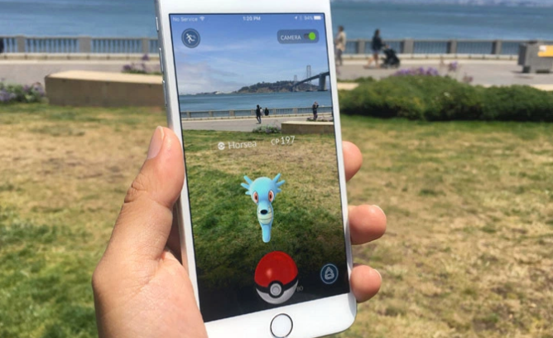

Slide 35
Current research
Systems for elderly
Accessibility (usable by as many people as possible)
Interaction with AI based systems
E.g. Automated vehicles
AR/VR systems
Mobile Apps
Contextual awareness
Delivering information at appropriate times and places
E.g.: pop-up reminders of what needs to be done,
Recommendation Systems
Crowd-sourcing
Health in remote areas

Slide 36
References
Mr. Behraj Khan, Lecturer, CS department
https://www.cs.bham.ac.uk/~rxb/Teaching/HCI%20II/intro.html
http://info.ils.indiana.edu/~hrosenba/S510/classes/hci_intro/hci_intro.pdf
https://www.interaction-design.org/

